Slide 1
芯片设计流程
iEDA课题组

Slide 2
01
芯片设计流程
02
设计思路
03
设计内容
04
设计方式

Slide 3
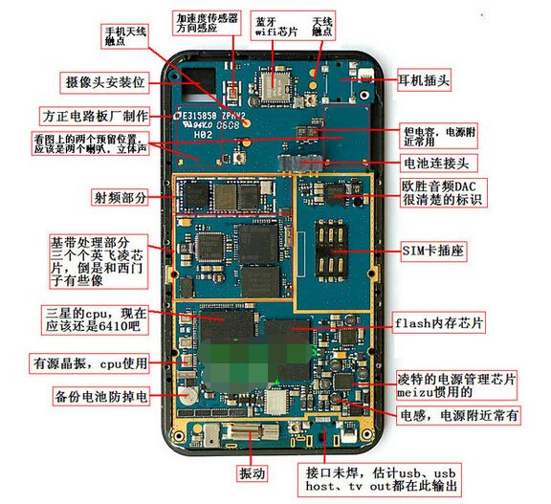
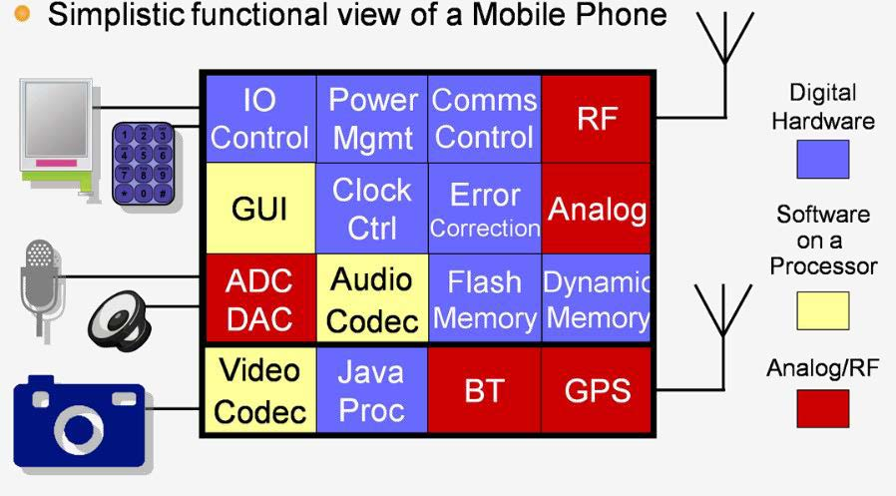
手机芯片模块
https://zhidao.baidu.com/question/122566460.html

Slide 4
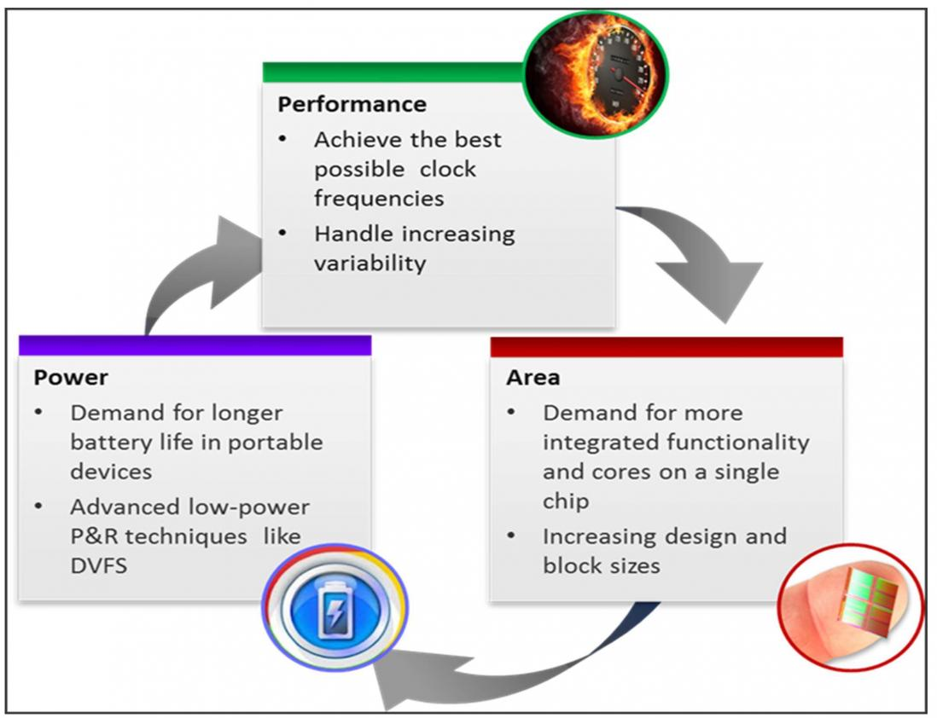
芯片设计目标
设计目标（PPA）
Performance 性能
Power 功耗
Area 面积
CPU系列 | 酷睿i9 11代系列
CPU主频 | 3.5GHz
最高睿频 | 5.3GHz
三级缓存 | 16MB
插槽类型 | LGA 1200
核心数量 | 八核心
线程数 | 十六线程
热设计功耗 | 125W
晶体管数量 | 70亿
https://semiwiki.com/eda/6349-how-to-nail-your-ppa-tradeoffs/

Slide 5
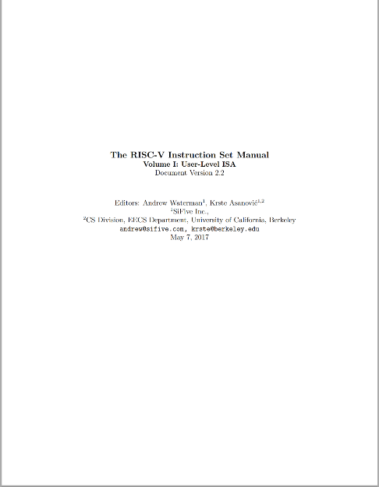
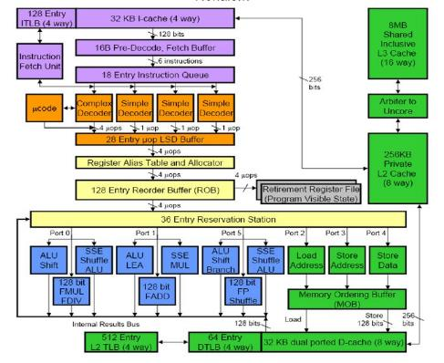
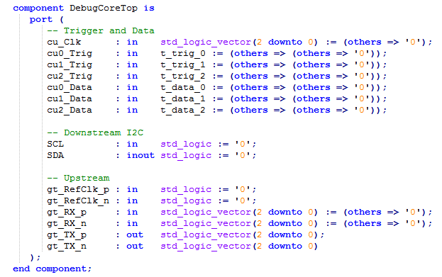
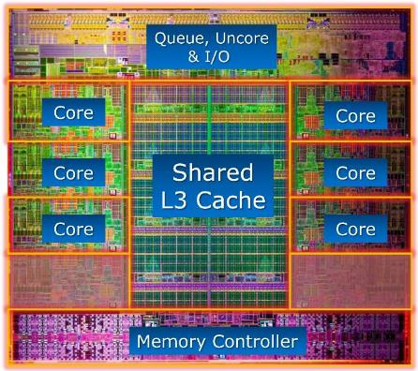
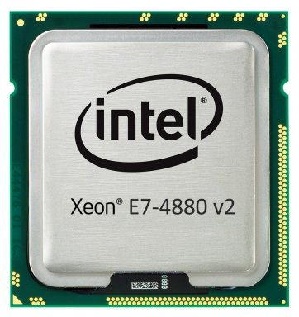
处理器芯片设计：从指令集到芯片
处理器架构设计：将指令集手册定义到功能实例化，形成设计文档；
功能开发：将设计文档开发成RTL级逻辑运算代码；
版图设计：用EDA工具将设计好功能等RTL代码物理化成GDS版图；
芯片制造：将设计好的版图通过光刻制造封装形成芯片；
微架构设计
工程开发
EDA工具
制造封装
指令集手册
设计文档
RTL代码
芯片版图
芯片产品

Slide 6
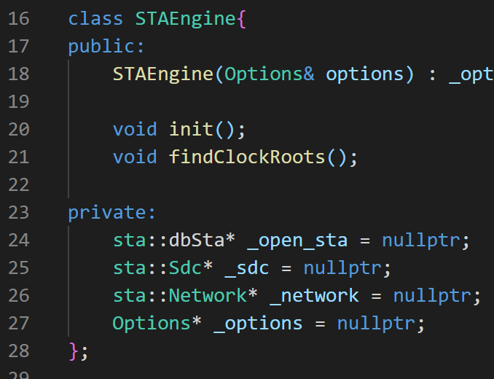
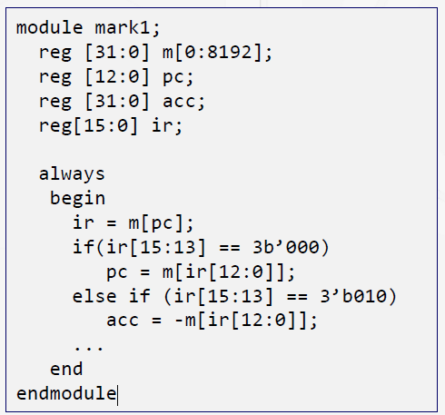
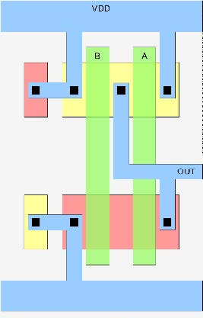
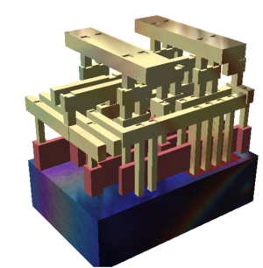
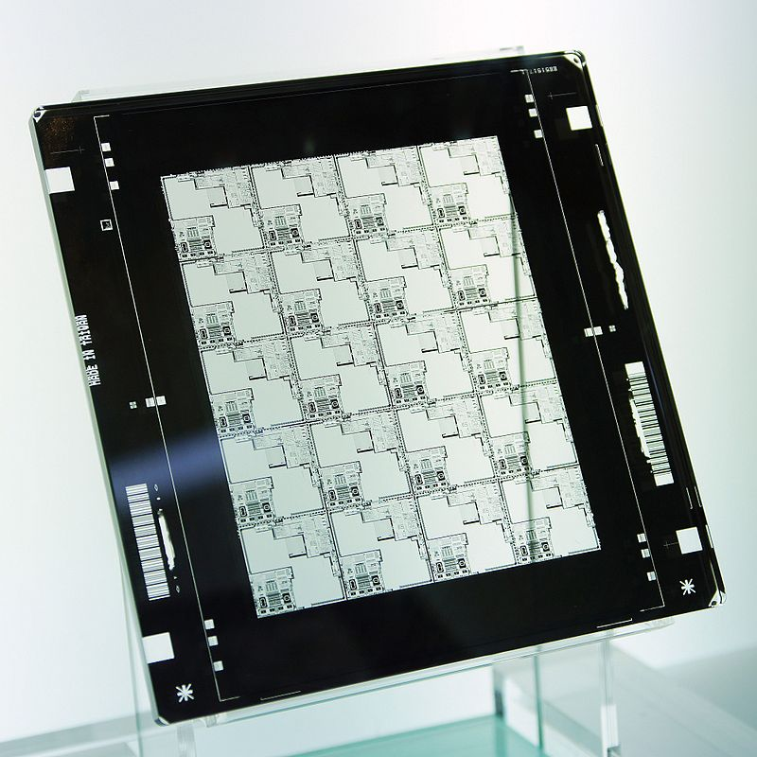
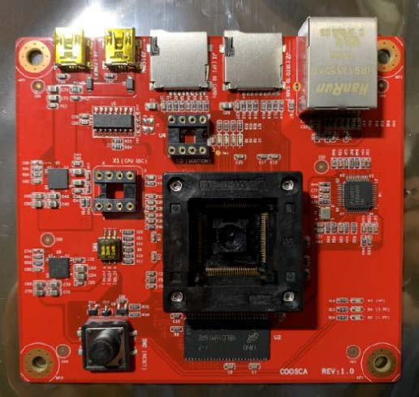
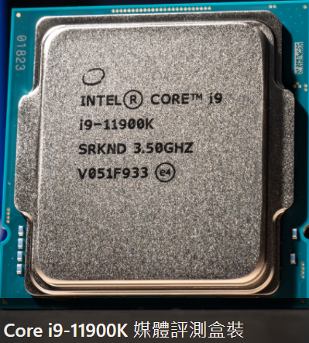
芯片设计层次
Chip Design Level
System Level
Register Transfer Level
Gate Level
Transistor Level
Layout Level
Gate Level
System Level
Register Transfer Level
Mask Level
PCB Level
Chip Level
Layout Level
Transistor Level
Mask Level

Slide 7
EDA问题拆解——模块
EDA Modules
EDA Platform
EDA Modules
逻辑综合 (Logic Synthesis)
物理设计 (Physical Design)
版图后处理 (Layout Post Processing)
单元库设计 (Standard Cell Library)
签核分析 (Signoff Analysis)
电路仿真 (Circuit Simulation)
物理验证 (Physical Verification)
封装测试 (Package and Test)
EDA数据库 (EDA Data Base)
芯片测试集 (Chip Benchmark)
GUI和智能流程 (GUI and Flow)
EDA Platform
……
……
Logic Synthesis
Logic Synthesis
Logic Synthesis
Logic Synthesis
Circuit Simulation
Circuit Simulation
Standard Cell Library
Standard Cell Library
Standard Cell Library
Standard Cell Library
Signoff Analysis
Design
Signoff Analysis
Design
EDA Flow
EDA Flow
Physical Design
Physical Design
Verification
Verification
Physical Verification
Physical Verification
Physical Verification
Physical Verification
Layout Processing
Layout Processing
Layout Processing
Layout Processing
Package
Package
Package
Manufacture Package
Test
Test
……
……

Slide 8
EDA问题拆解——模块
Functional
Verification
Design
……
Standard Cell Library
System Architecture
Functional Design
Logic Synthesis
Physical Design
Layout Processing
Manufacture Package
Circuit Simulation
Signoff Analysis
Physical Verification
Test
Verification

Slide 9
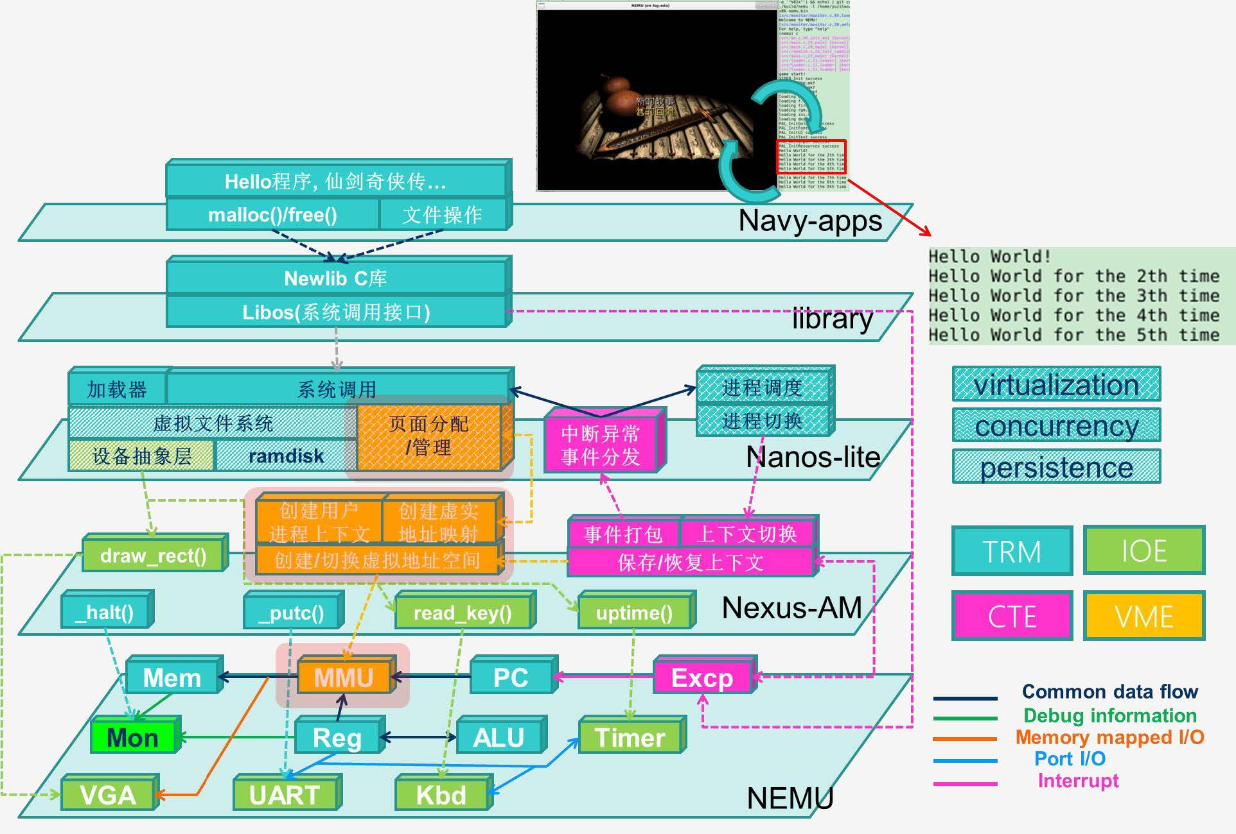
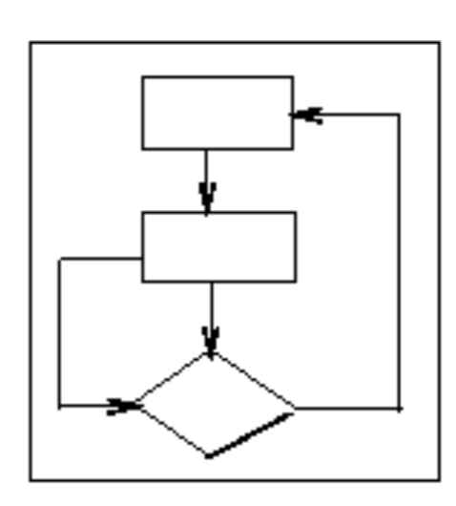
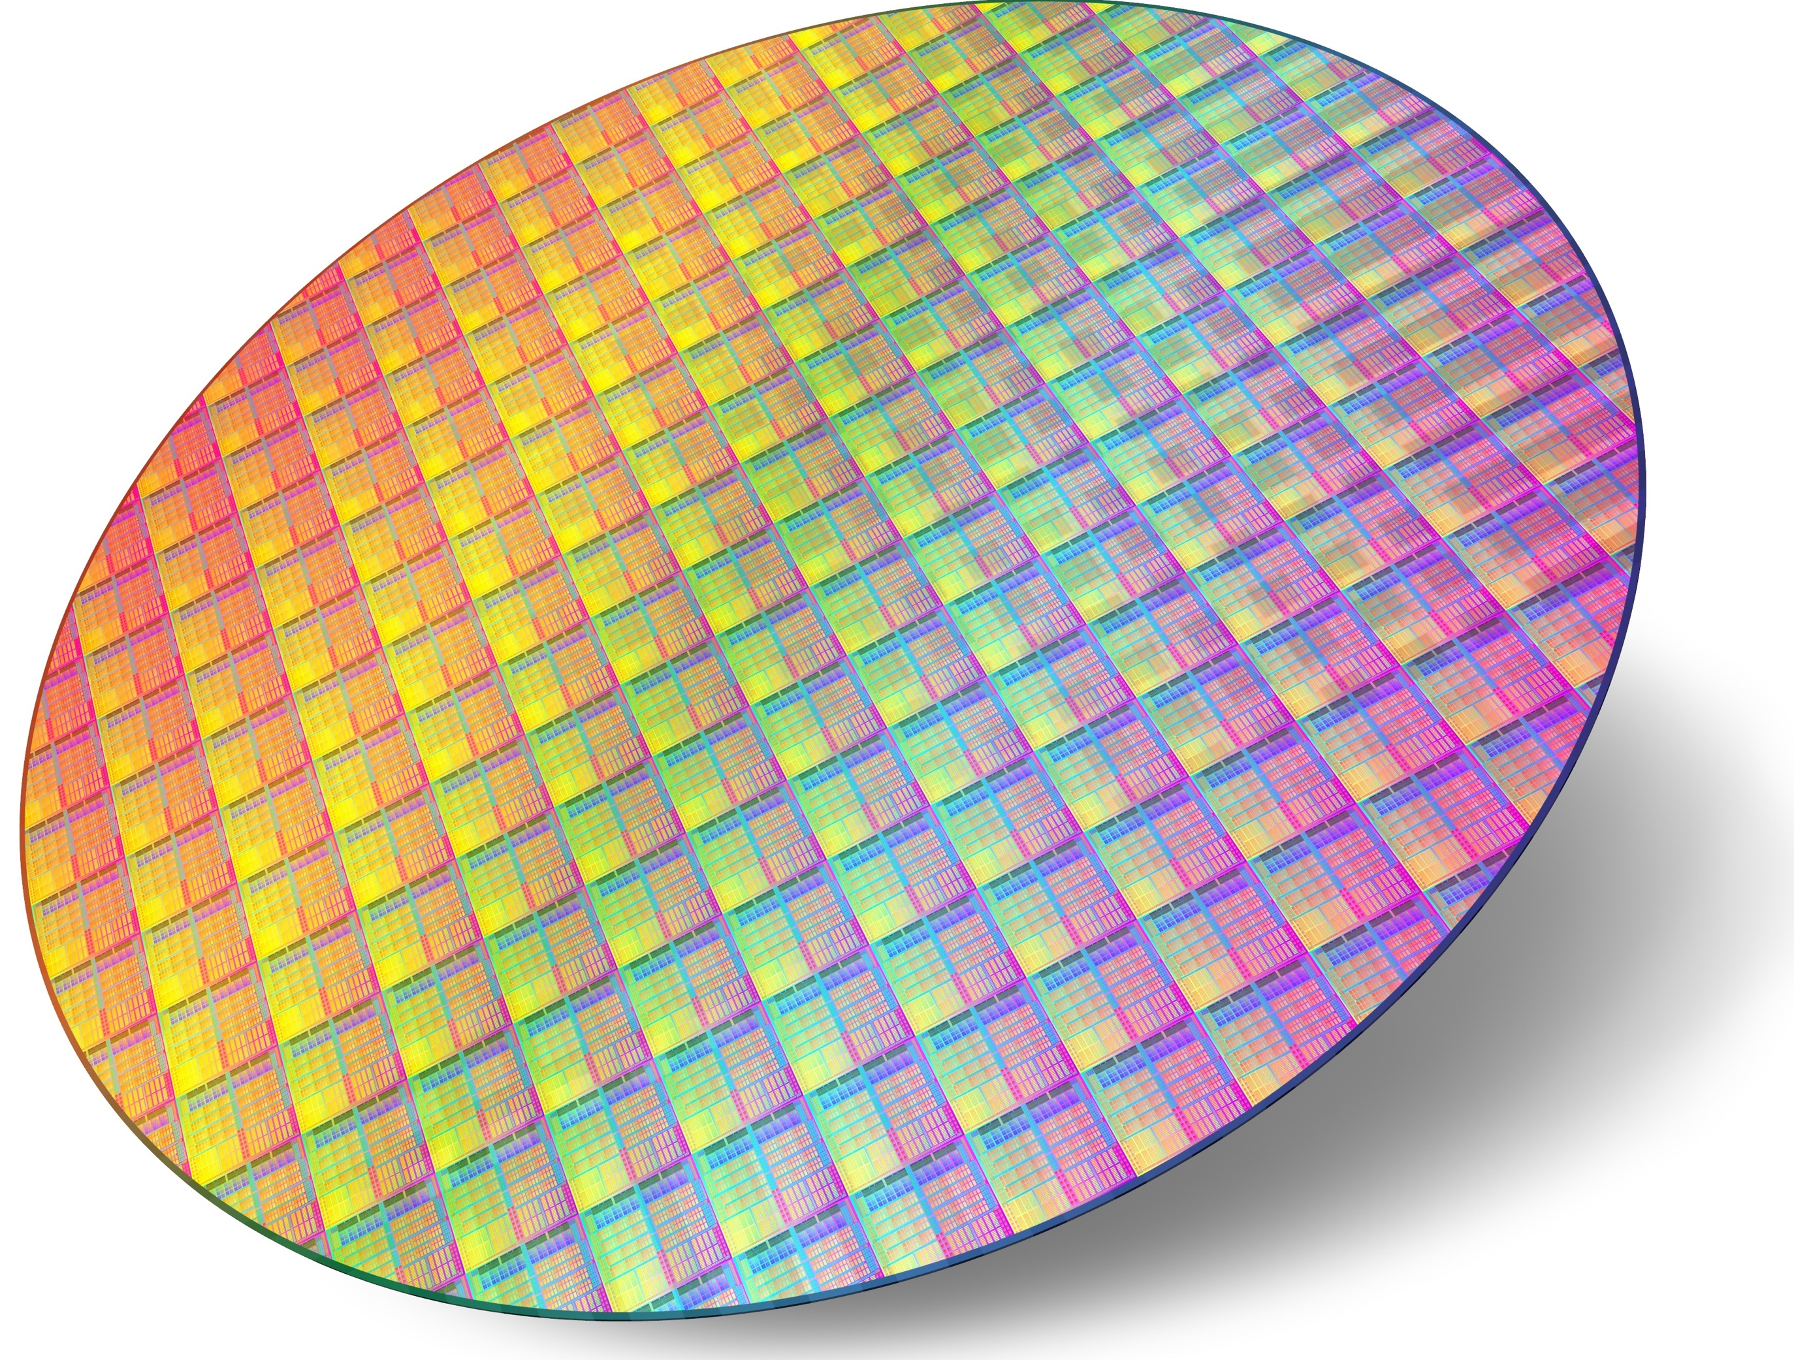
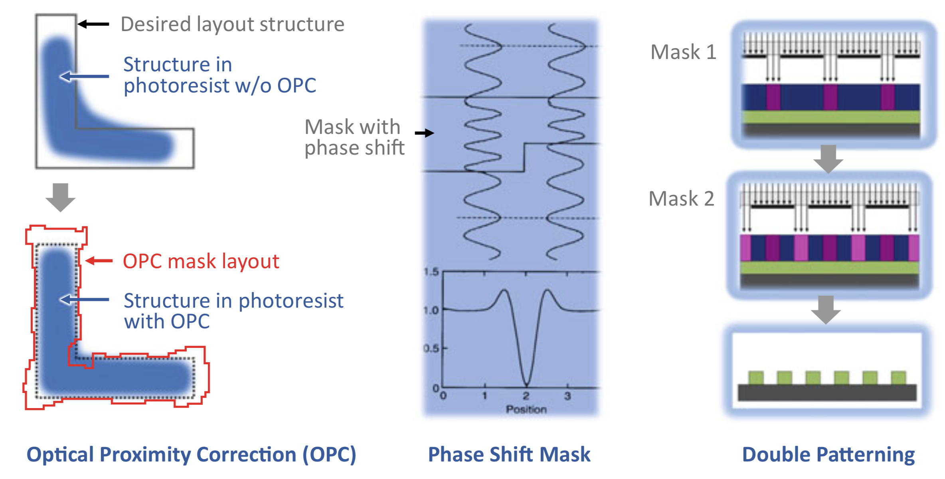
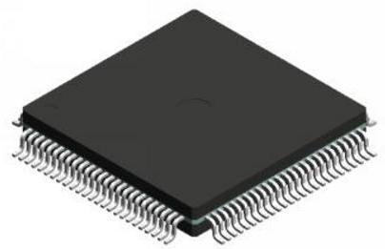
设计过程
System Specifications
Architectural Design
Functional Design
Logic Synthesis
Tech Mapping
module conv;
reg [31:0] m[0:8192];
reg [12:0] pc;
reg [31:0] acc;
reg[15:0] ir;
always
begin
ir = m[pc];
if(ir[15:13] == 3b’000)
pc = m[ir[12:0]];
else if (ir[15:13] == 3’b010)
acc = -m[ir[12:0]];
...
X
Y
D
Package and Test
Fabrication
Layout Processing
Physical Verification
Physical Design
Timing DRC
DRC
ERC
LVS

Slide 10
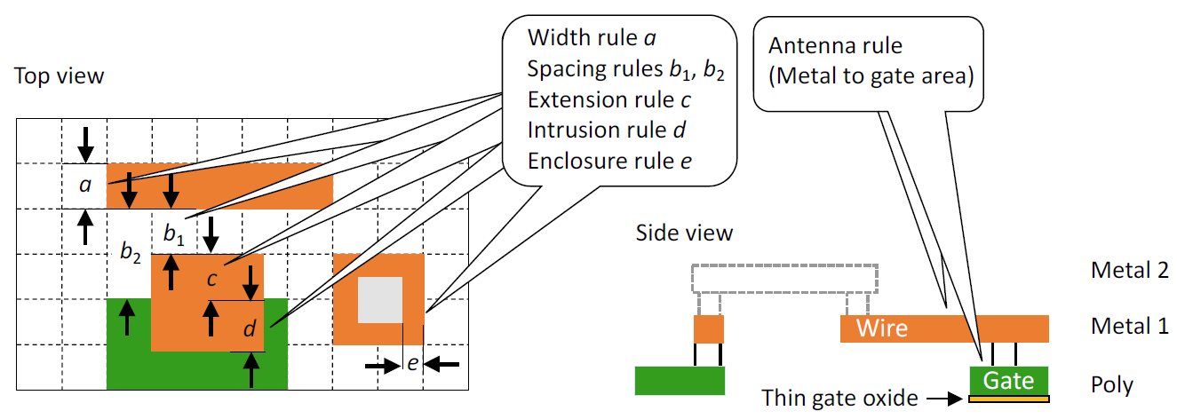
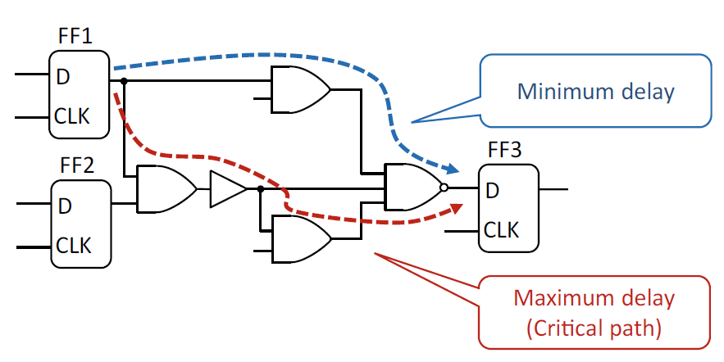
EDA工具链组成
Verification
PCB
module conv;
reg [31:0] m[0:8192];
reg [12:0] pc;
reg [31:0] acc;
reg[15:0] ir;
always
begin
ir = m[pc];
if(ir[15:13] == 3b’000)
pc = m[ir[12:0]];
else if (ir[15:13] == 3’b010)
Functional Verification
Specifications
Formal Verification
Architectural Design
Chip
Equivalence Check
Functional Design
Simulation
Package and Test
Simulation (Circuit)
Logic Synthesis
Logic Compiling
Fabrication
Emulation (System)
Logic Optimization
Std Cell Lib
Layout Processing
Device Modeling
Tech Mapping
Mask Generation
Parasitic Extraction
ATPG/BIST
RET/OPC/ILT
DRC/LVS
Physical Design
Floorplan
Post Simulation
Analysis
RC Extraction
Placement
Physical Verification
Timing Analysis
Timing Optimization
ESD/CD
Power
Clock Tree Synthesis
LVS
Noise
Routing
ERC
IR Drop
ECO
DRC (MP)

Slide 11
设计过程
System Specifications
需求要素
Target market,
Desired performance,
Power targets,
Interface IP requirements,
Use cases
This input provides the foundation for a chip’s specification and architecture development.
Power requirements should be very detailed, identifying power domains; dynamic voltage and frequency scaling; adaptive voltage and frequency scaling; and power modes.
In addition, designers should specify die size, pin-count, IP configuration freeze and any custom IP requirements.
Requires computational power to run imaging algorithms to support virtual reality.
Requires two ARM A53 processors with coherent interconnect and should run at 600 MHz.
Requires USB 3.0, Bluetooth and PCIe 2nd gen interfaces.
Should support 1920x1080 pixel display with appropriate controller hen specifying a chip.
Architectural Design
Functional Design
Logic Synthesis
Tech Mapping
Physical Design
Physical Verification
Sign Off
Layout Processing
Fabrication
Package and Test

Slide 12
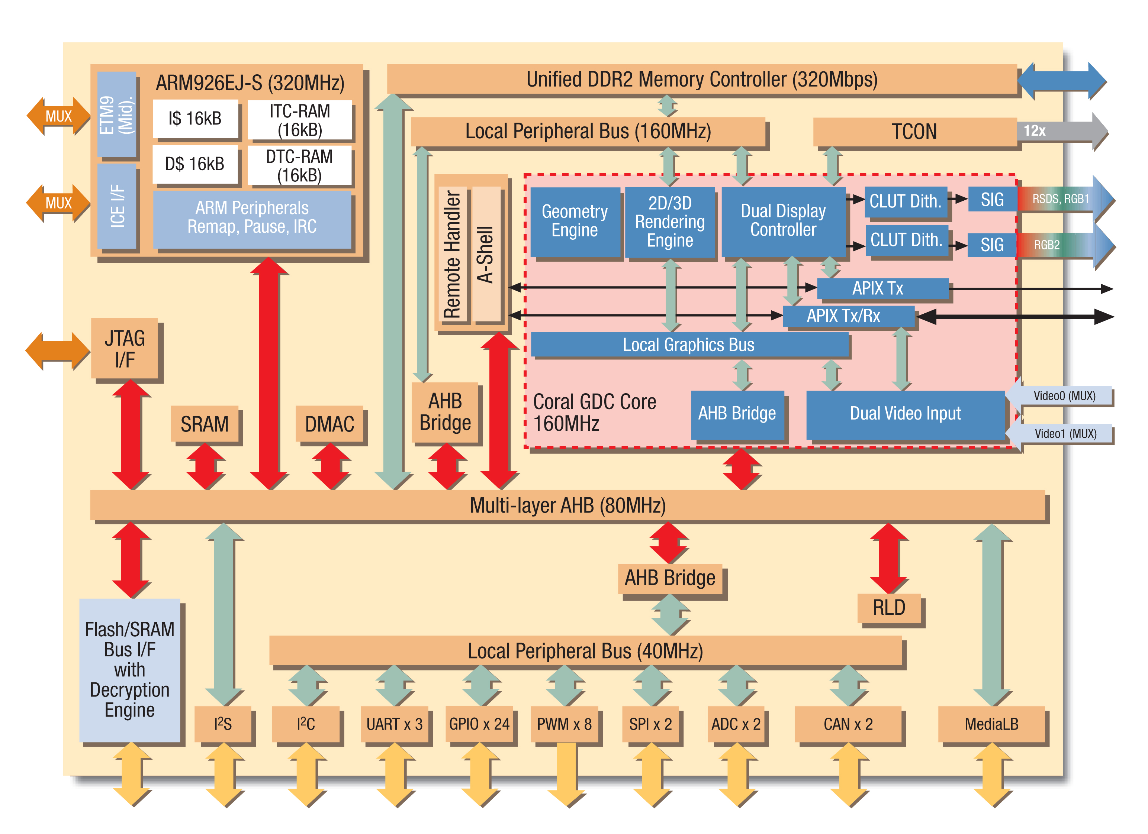
设计过程
System Specifications
Architectural Design
Functional Design
Logic Synthesis
Tech Mapping
Physical Design
Physical Verification
Sign Off
Layout Processing
Fabrication
Package and Test
https://www.chipverify.com/verilog/asic-soc-chip-design-flow

Slide 13
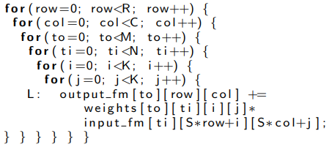
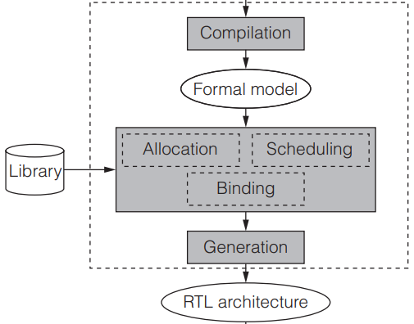
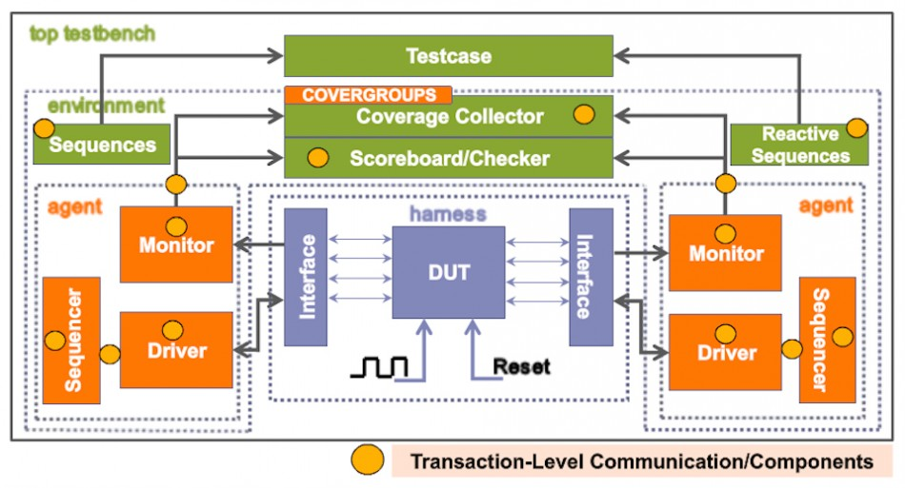
设计过程
System Specifications
Architecture Design Decision
System Specifications
Architectural Design
IP Provision
3rd-party / In-house
Inputs:
Firmware, Application Code, RTL, Assertions, Design, Database, System C Models, High-Level Models, Test Benches
Functional Design
Instruction Set,
Simulator
Logic Synthesis
APIs
Structure
Behavioral H/W Descript
Tech Mapping
Verification
Simulation
Behavioral RTL
High-Level Synthesis
Physical Design
Physical Verification
Sign Off
module conv;
reg [31:0] m[0:8192];
reg [12:0] pc;
reg [31:0] acc;
reg[15:0] ir;
always
begin
ir = m[pc];
if(ir[15:13] == 3b’000)
pc = m[ir[12:0]];
else if (ir[15:13] == 3’b010)
acc = -m[ir[12:0]];
...
Layout Processing
Fabrication
Package and Test

Slide 14
设计过程
System Specifications
Architectural Design
Functional Design
Logic Synthesis
Tech Mapping
Physical Design
Physical Verification
Sign Off
Layout Processing
Fabrication
Package and Test

Slide 15
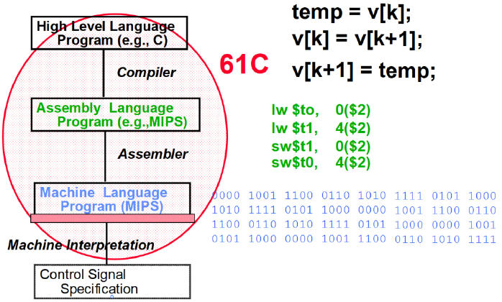
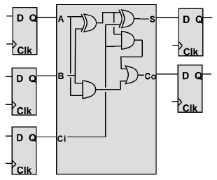
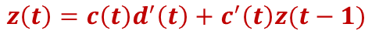
设计过程——逻辑综合
RTL
System Specifications
module conv;
reg [31:0] m[0:8192];
reg [12:0] pc;
reg [31:0] acc;
reg[15:0] ir;
always
begin
ir = m[pc];
if(ir[15:13] == 3b’000)
pc = m[ir[12:0]];
else if (ir[15:13] == 3’b010)
acc = -m[ir[12:0]];
...
Compilation
Architectural Design
Functional Design
Logic Synthesis
Tech Mapping
Library Definition
Library
abcd f
0 0000 0
1 0001 1
2 0010 0
3 0011 1
4 0100 0
5 0101 1
6 0110 0
7 0111 0
Physical Design
00/0,01/0,11/0
10/1
FSM
Elaboration
Physical Verification
z=0
z=1
Sign Off
Binding
11/0
00/1,01/1,10/1
$$z\left(t\right)=c\left(t\right)d^{′}\left(t\right)+c^{′}\left(t\right)z(t−1)$$
Layout Processing
Logic Optimization
Logic Representation
Logic Minimization
Factored Forms
Division
Don’t Cares
Fabrication
Package and Test
Constraint
Set ports
Set regs
Read sdc
Create clock
Set area
…

Slide 16
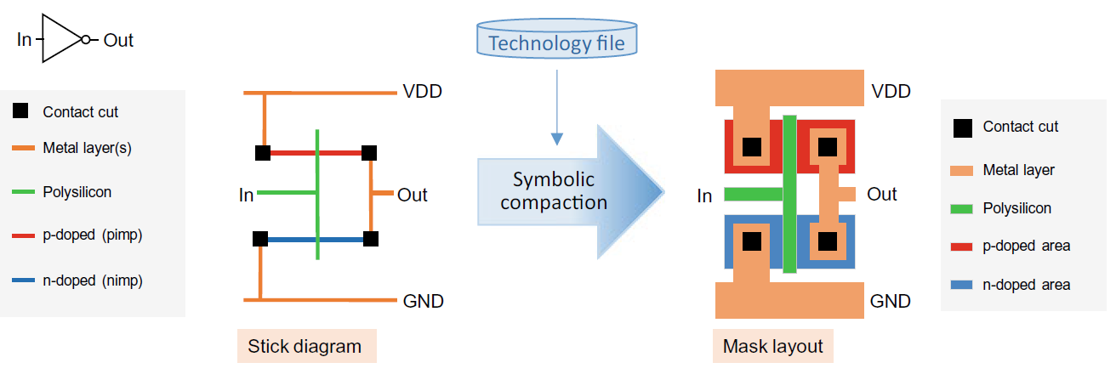
设计过程——逻辑综合
System Specifications
Standard Cell Library
Symbol (.svg)
Behavioral (.v)
Physical
Layout (.gds)
Abstract (.lef)
Transistor (.spi)
Timing/Power (.lib)
Functional
Combinational
Buffer
Sequential
Physical
Type
Voltage
Drive Strength
Size
Architectural Design
Functional Design
Logic Synthesis
Tech Mapping
SPICE Model
Liberty
(.lib)
Analysis
Physical Design
Synthesis
Physical Design
Liberate
Characterization
Physical Design
Netlist
(.v)
PEX Parameter
(.pex)
Validation
Verification
Physical Verification
PEX
Extraction
LVS
DRC
Sign Off
Symbol
(.svg)
Schematic
(.cdl)
Layout
(.gds)
Abstract
(.lef)
Layout Processing
Draw
CDL Extraction
GDS Extraction
Abstract
Fabrication
Standard Cell Liberty
.svg, .cdl, .gds, .lib, .lef, .v
Tech Device
Tech Design Rule
Package and Test

Slide 17
设计过程——逻辑综合
System Specifications
Process Design Kit
针对选择的每种类型门器件，对其进行Schematic设计，并进行电路仿真得到电学参数；
选择工艺和器件模型，进行门器件Layout设计，获得GDS版图；
对工艺提取技术约束TechFile，形成DRC/LVS和提取参数；
Architectural Design
Functional Design
Device Primitives
(P/N Mos, BJTs, Diodes, Resistor, Capacitor)
Logic Synthesis
Schematic Capture
Tech Mapping
Symbol & Schematic
Physical Design
Analog Simulation
SPICE Model
Process Design Kit
(Device, Schematic, Pcell, TechFile, DRC/LVS/RCX)
Physical Verification
Layout
Parameter Cell
Cell
Physical Design & Verification
Standard Cell Liberty
.svg, .cdl, .gds, .lib, .lef, .v
Sign Off
Tech File
(Layer Map, Layer Props, Symbolics, Connectivity)
Layout Processing
Chip Assembly
Fabrication
Verification
(DRC, LVS, RCX)
Physical Verification
Package and Test

Slide 18
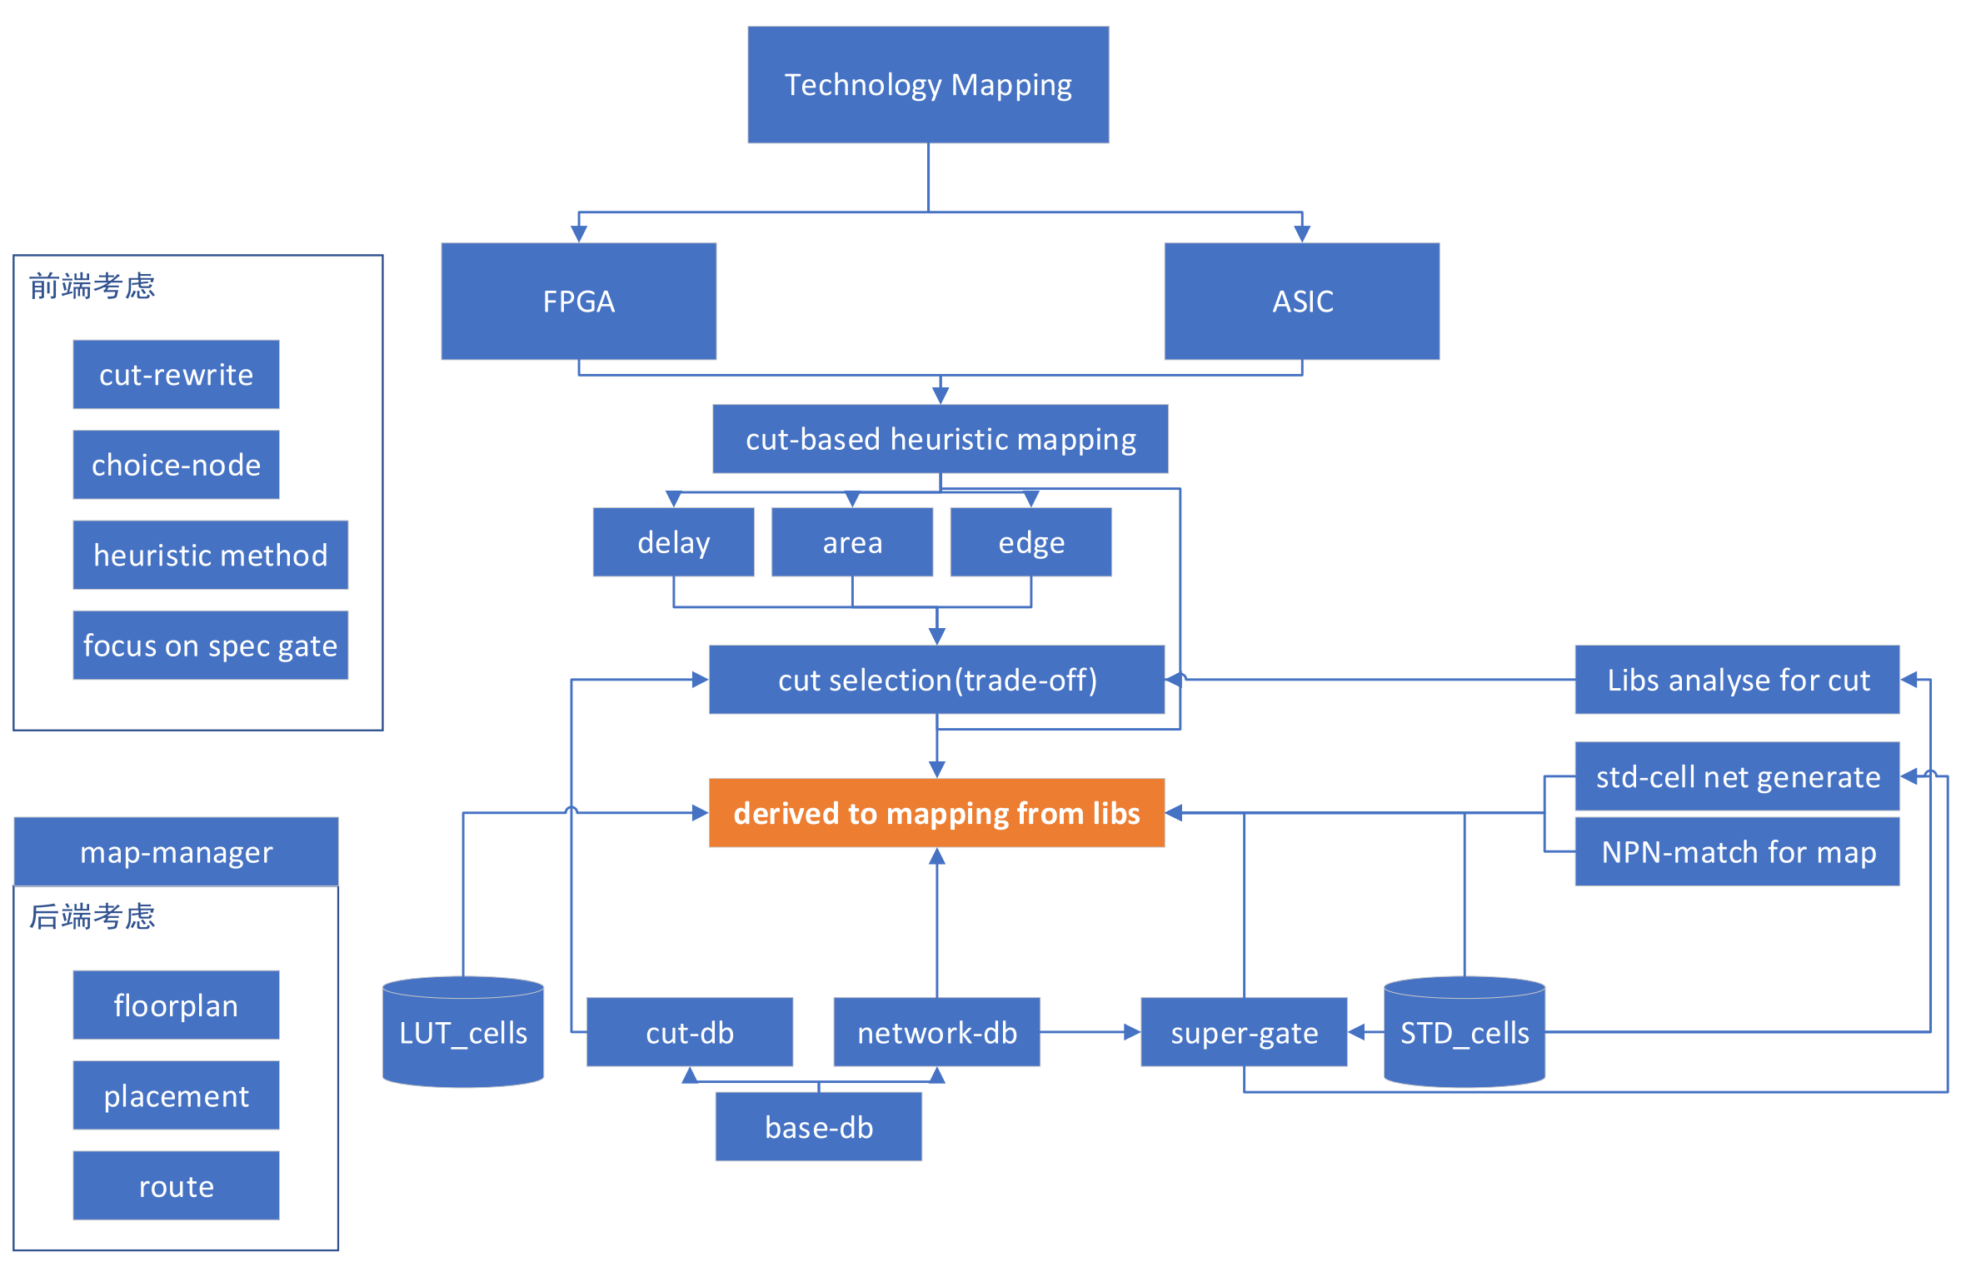
设计过程——工艺映射
System Specifications
Logic
Re-Optimization
Balance
Rewrite
Refactor
Resubsti-
tution
Desomposition
Partition
Architectural Design
Functional Design
Tech Mapping
Logic Synthesis
Tech Mapping
Simulation
Physical Design
Equivalence Checking
Physical Verification
Sign Off
Timing/Power Analysis
Layout Processing
Test Logic Insertion
Fabrication
Package and Test
Physical Synthesis

Slide 19
设计过程——工艺映射
System Specifications
Architectural Design
Functional Design
Logic Synthesis
Tech Mapping
Physical Design
Physical Verification
Sign Off
Layout Processing
Fabrication
Package and Test

Slide 20
设计过程——物理设计
System Specifications
Architectural Design
Functional Design
Logic Synthesis
Tech Mapping
Physical Design
Physical Verification
Sign Off
Floorplan：确定Die和Core大小，确定IO位置，规划Macro的摆放，设计电源线，放置物理单元。
Placement：摆放标准单元至合法的位置，插入填充单元，进行时序优化，使得设计目标最优。
CTS：设计时钟网络，连接每个FF的时钟pin。实现时钟同步，功耗低等目标。
Routing：将连接单元pin的Net在规定的金属层的Track上实体化，使得线长短，时序功耗低，设计规则满足。
Layout Processing
Fabrication
Package and Test

Slide 21
设计过程——物理设计
System Specifications
Architectural Design
Functional Design
Logic Synthesis
Tech Mapping
布局
Physical Design
布图
Physical Verification
Sign Off
Layout Processing
Fabrication
Package and Test
布线

Slide 22
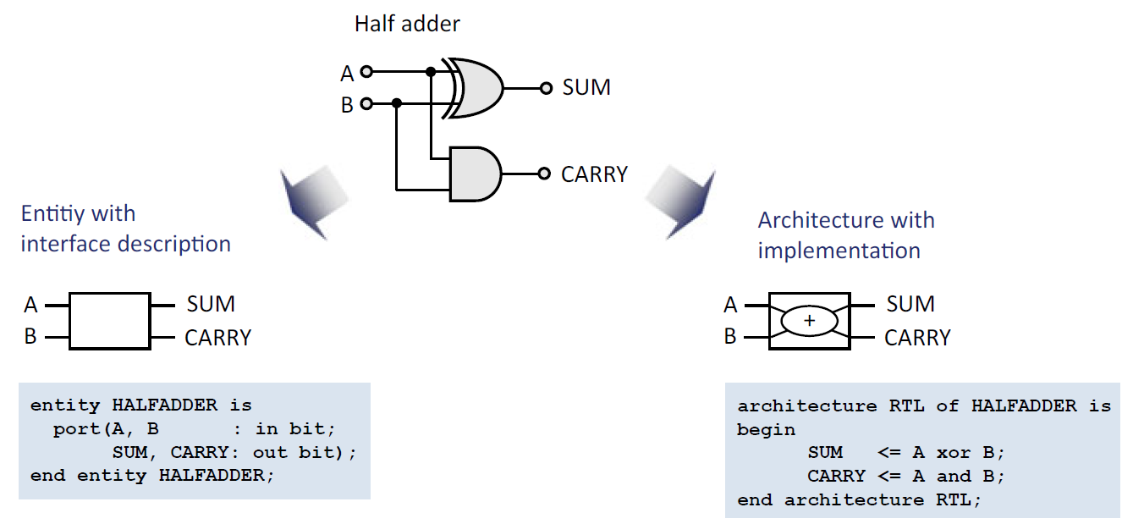
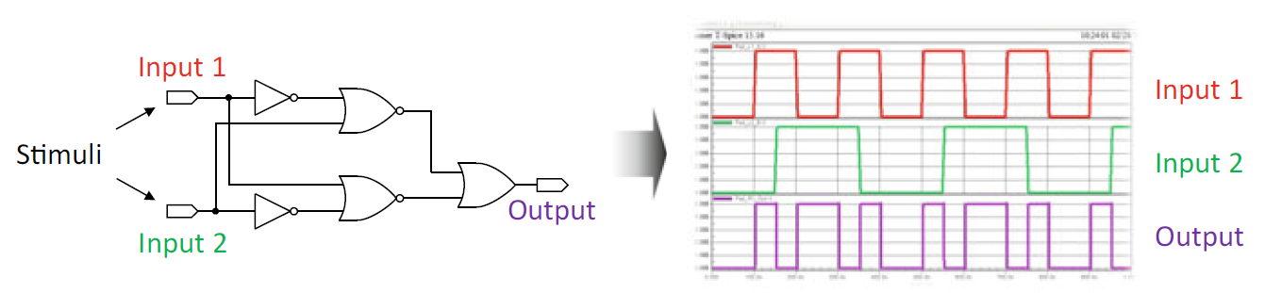
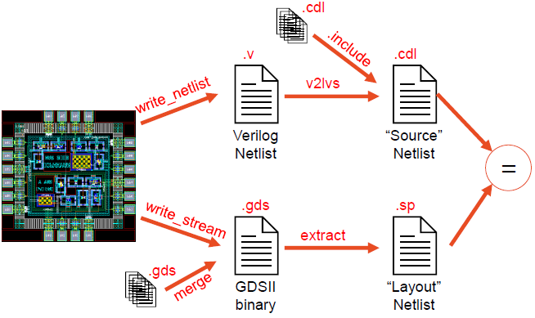
设计过程——验证
System Specifications
Formal
Architectural Design
Formal Verification
Functional Design
Simulation
Logic Synthesis
Simulation Verification
LVS
Tech Mapping
Timing Verification
Physical Design
Geometric
(DRC, ERC)
Physical Verification
Timing
Sign Off
Extraction
(LVS)
DRC/ERC
Layout Processing
Fabrication
Package and Test

Slide 23
设计过程——验证
System Specifications
Architectural Design
IN1
A
Z
I
O
D
Q
Functional Design
B
A
OUT
CLK
B
Z
D
Q
CLK1
I
O
Setup/Hold Check
Logic Synthesis
IN2
D
Q
CLK
RC Extraction
I
O
CLK2
PLL
Div
CLK
Tech Mapping
A
Z
GATE
B
Timing
Physical Design
Physical Verification
Noise
IN1
check
OUT
Sign Off
CLK1
check
Power
IN2
Layout Processing
check
CLK2
Fabrication
IR Drop
GATE
Package and Test

Slide 24
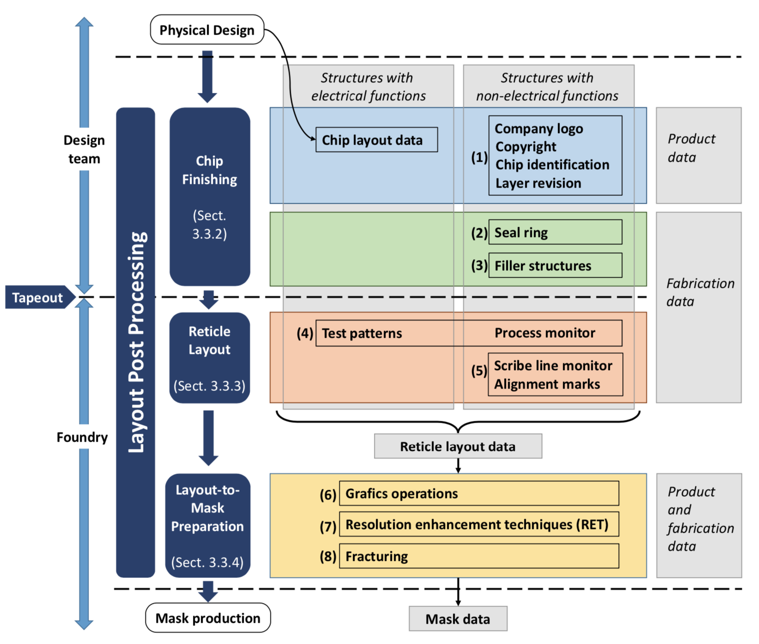
设计过程——版图后处理
System Specifications
Architectural Design
Functional Design
Logic Synthesis
Tech Mapping
Physical Design
Physical Verification
Sign Off
Layout Processing
Fabrication
Package and Test

Slide 25
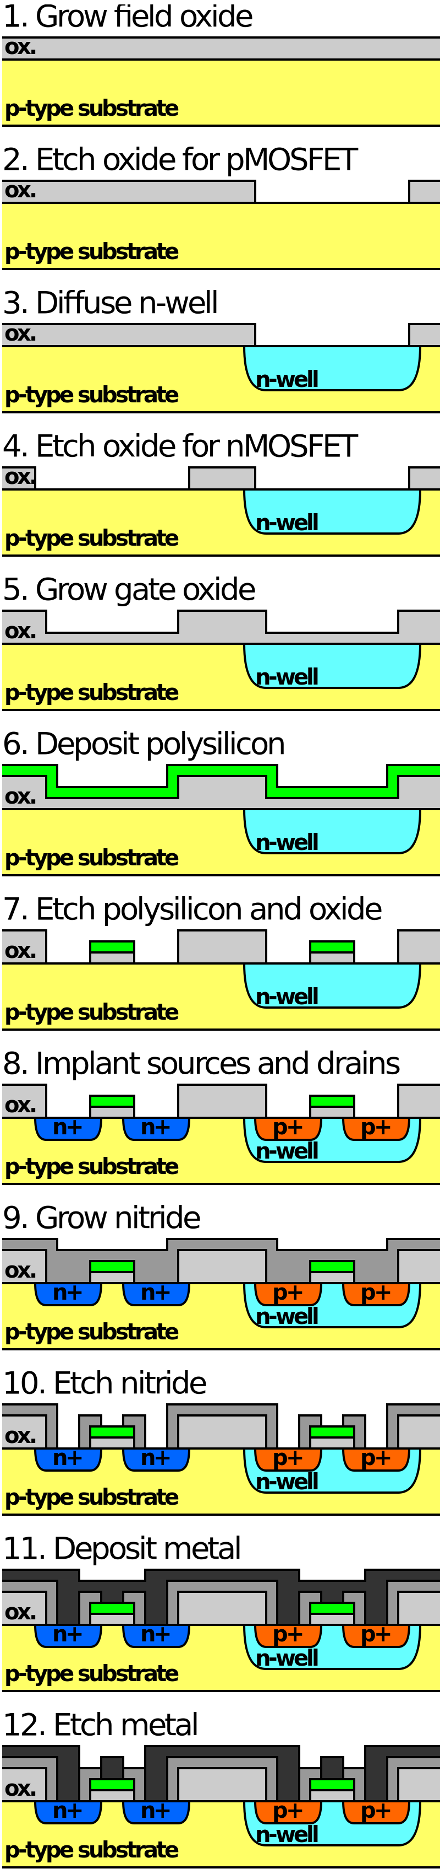
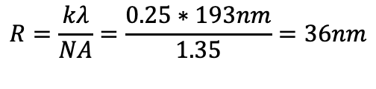
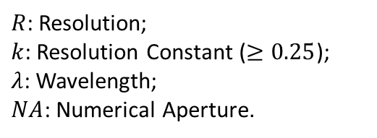
设计过程——制造
System Specifications
Light source
Architectural Design
Illumination
Lens
Functional Design
Mask
Logic Synthesis
Projection
Tech Mapping
Lens
Physical Design
Immersion
Wafer
Physical Verification
$$R=\frac{kλ}{NA}=\frac{0.25∗193nm}{1.35}=36nm$$
Sign Off
Layout Processing
$R$: Resolution;
$k$: Resolution Constant ($≥0.25$);
$λ$: Wavelength;
$NA$: Numerical Aperture.
Fabrication
Package and Test
https://en.wikipedia.org/wiki/Back_end_of_line

Slide 26
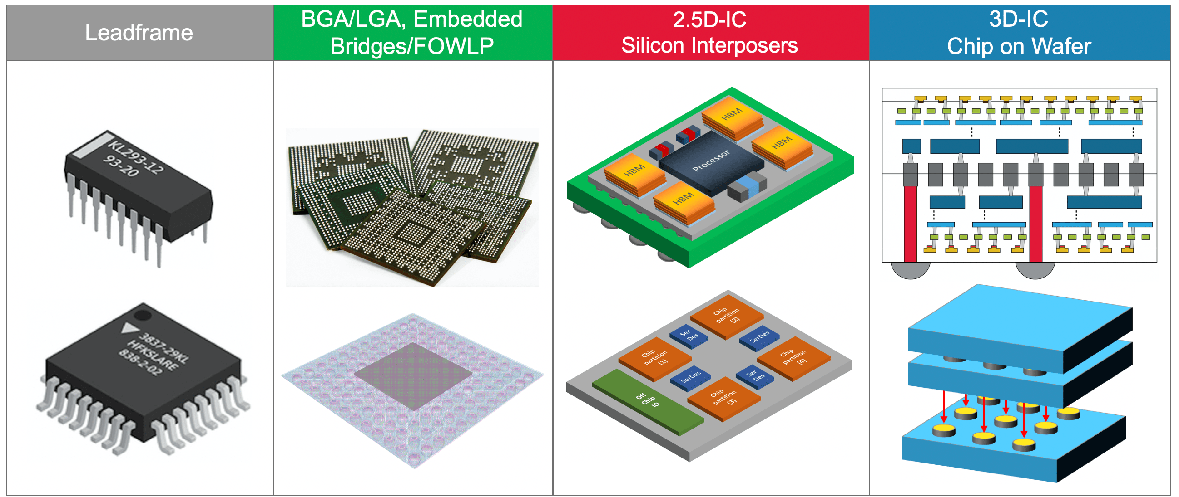
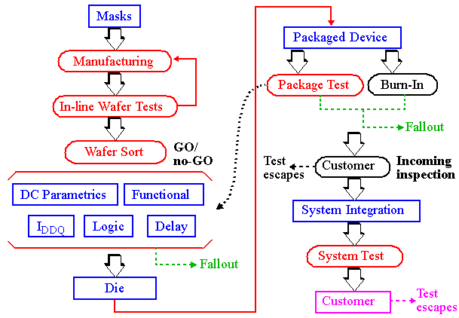
设计过程——封装测试
System Specifications
Architectural Design
Functional Design
Logic Synthesis
Tech Mapping
Physical Design
Physical Verification
Sign Off
Layout Processing
Fabrication
Package and Test
http://ece-research.unm.edu/jimp/vlsi_test/slides/html/overview1.htm

Slide 27
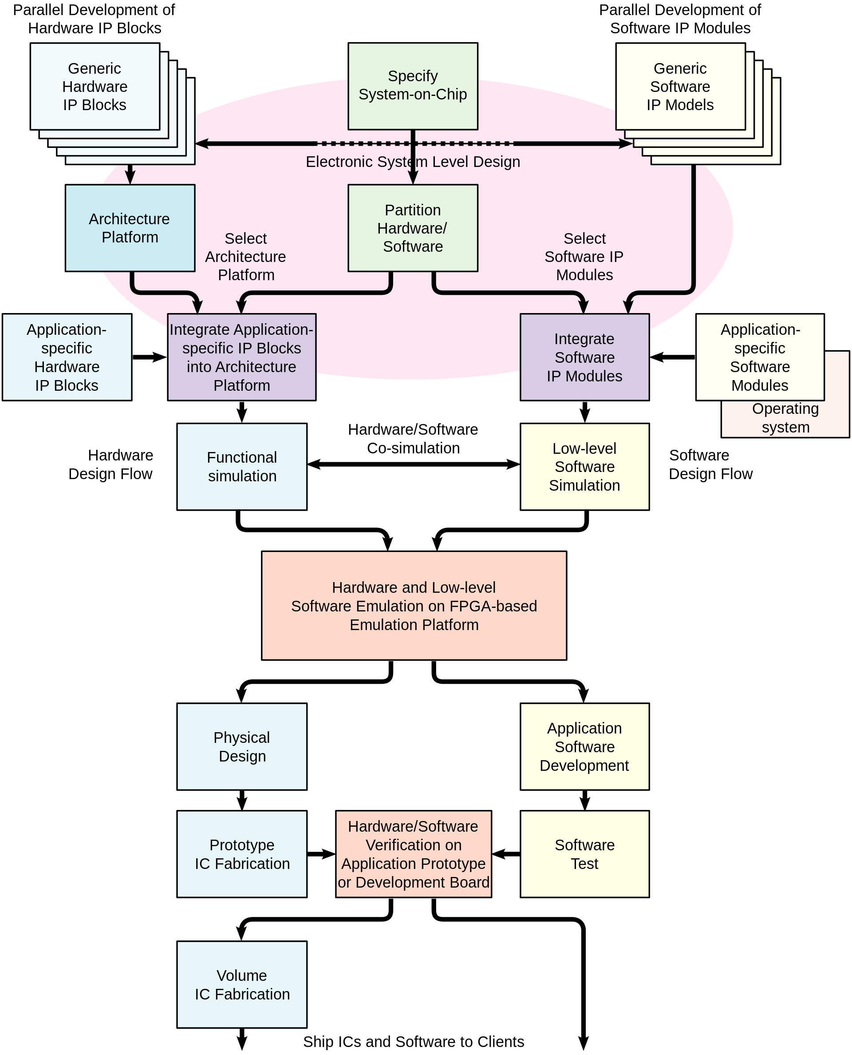
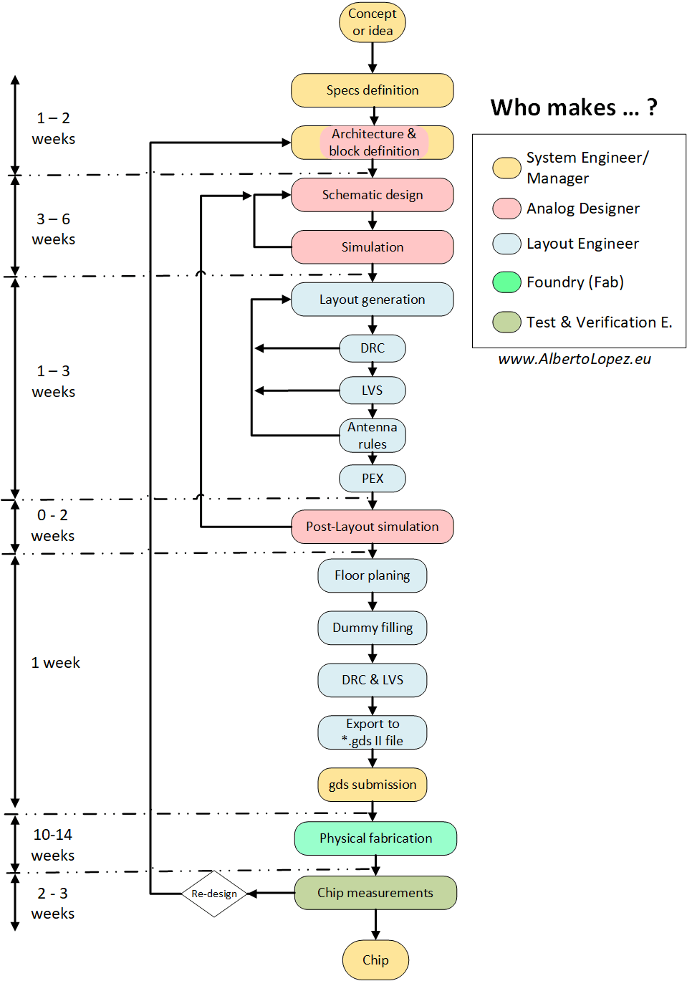
IC设计流程

Slide 28
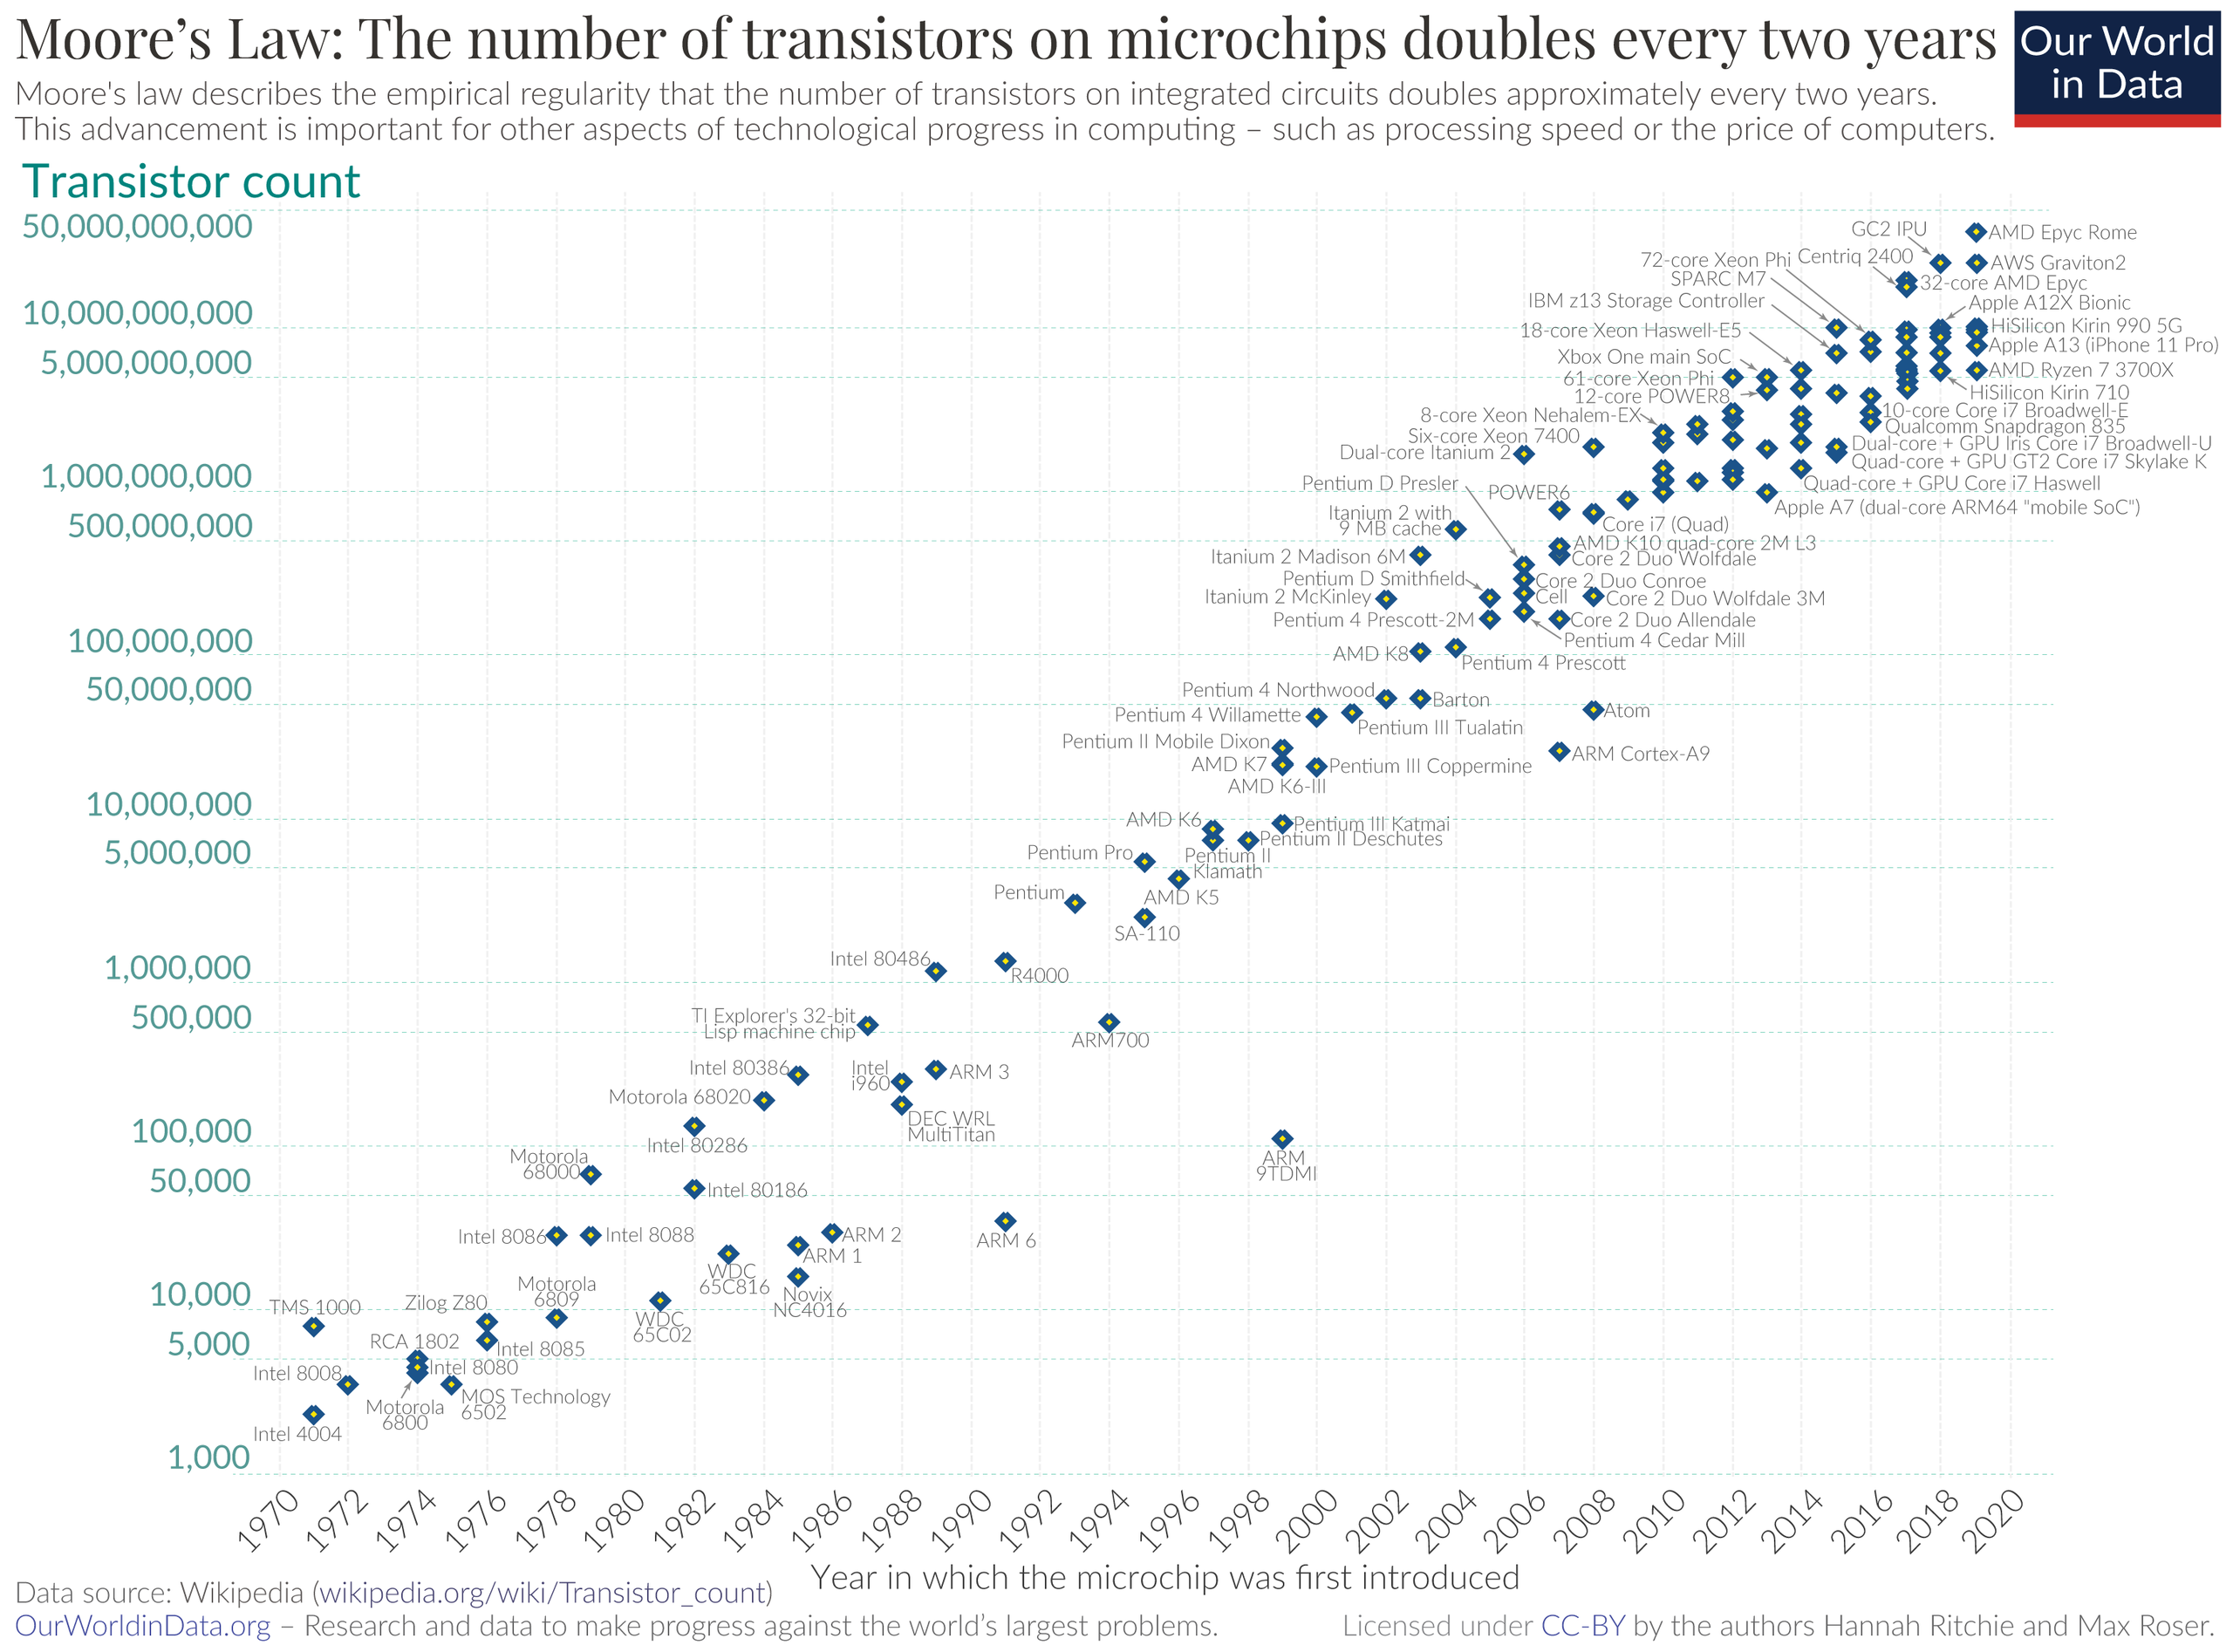
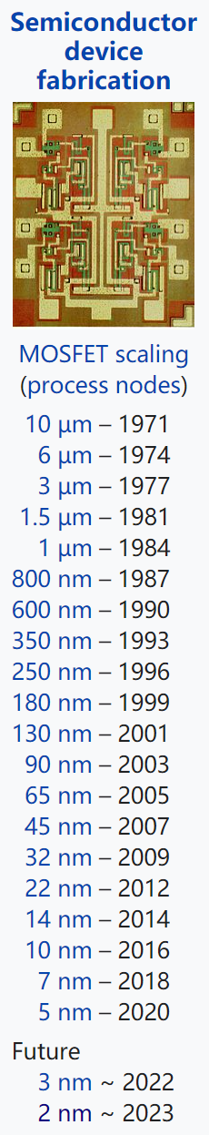
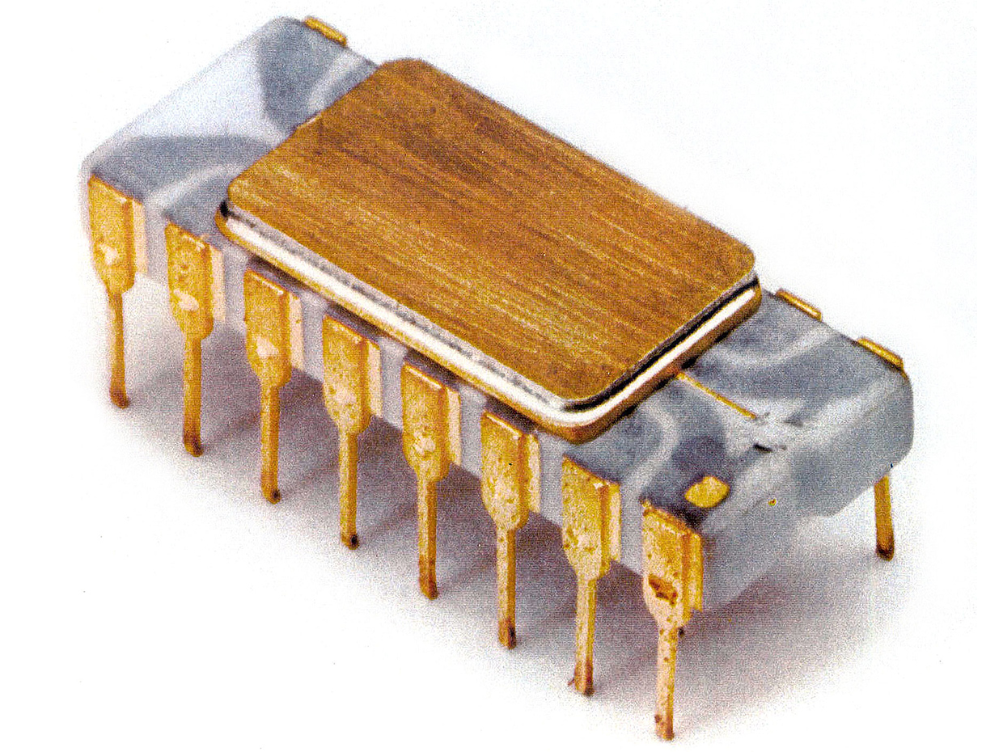
摩尔定律
每隔2年，芯片中晶体管数量将翻倍，晶体管大小缩小一半
Intel 4004
1971年1月 霍夫
4位微处理器
2250个晶体管
3mm×4mm
性能远超ENIAC
200美元
740 kHz
加两个8位数需850μs
12位地址
8位指令
640字节RAM
包含16个寄存器
CPU系列 | 酷睿i9 11代系列
CPU主频 | 3.5GHz
最高睿频 | 5.3GHz
三级缓存 | 16MB
核心数量 | 八核心
线程数 | 十六线程
热设计功耗 | 125W
晶体管数量 | 70亿
工艺 | 14nm
面积 | 37.5×37.5mm
内存 | DDR4 3200MHz
指令 | 64位指令
内存带宽 | 50GB/s
高通48核Centriq，拥有超过180亿个晶体管
第一颗
当前最强

Slide 29
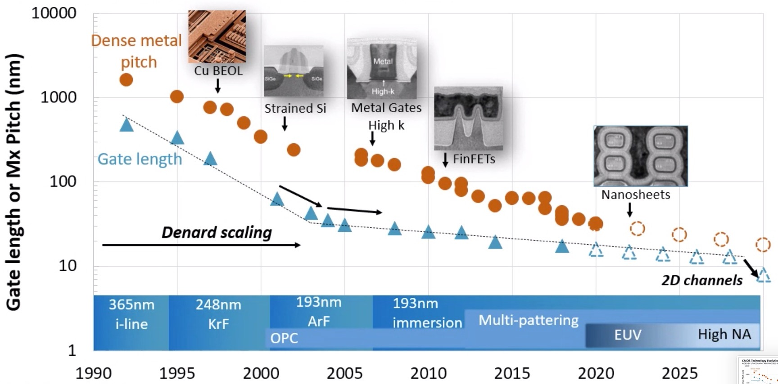
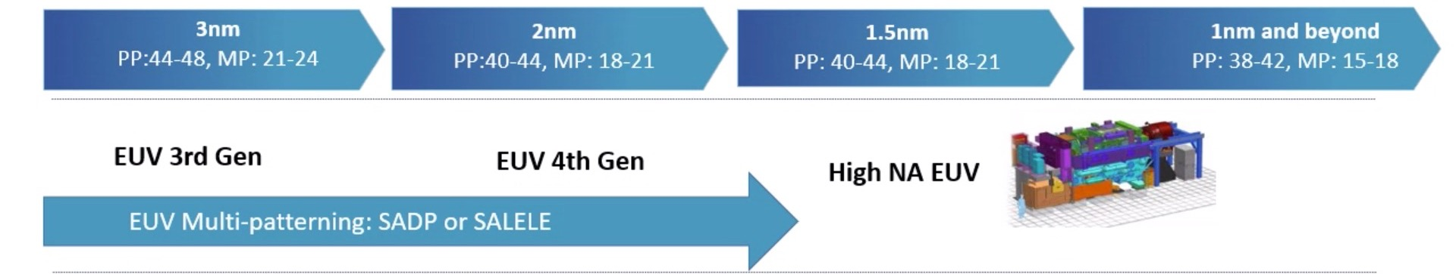
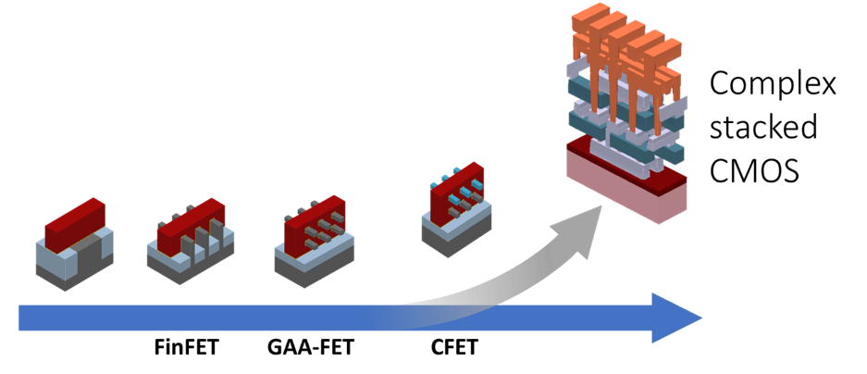
工艺演化
材料器件：用于缩小沟道宽度，减少MOS管大小，进而减小单元大小，以从设计上实现尺寸摩尔定律
Dense Metal Pitch, Cu BEOL, Strained Si, Metal Gate, FinFets, GAA Nanosheets, CFet, Complex Stacked
光刻机：用于制造芯片，能够保证波长不断缩小，进而提高Pattern分辨率，以从制造上实现尺寸摩尔定律
UV 365nm i-line, 248nm KrF，193nm DUV ArF, DUV Immersion, DUV-MP, 13.5nm EUV, EUV-MP, High-NA EUV
800-250
130-65
28-7
7-2
180-130
65-28
https://semiengineering.com/imecs-plan-for-continued-scaling/

Slide 30
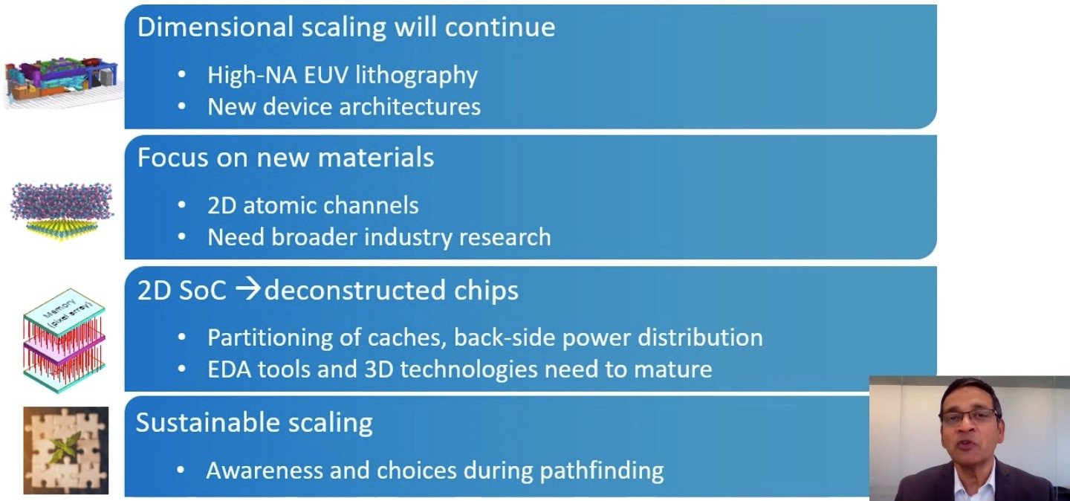
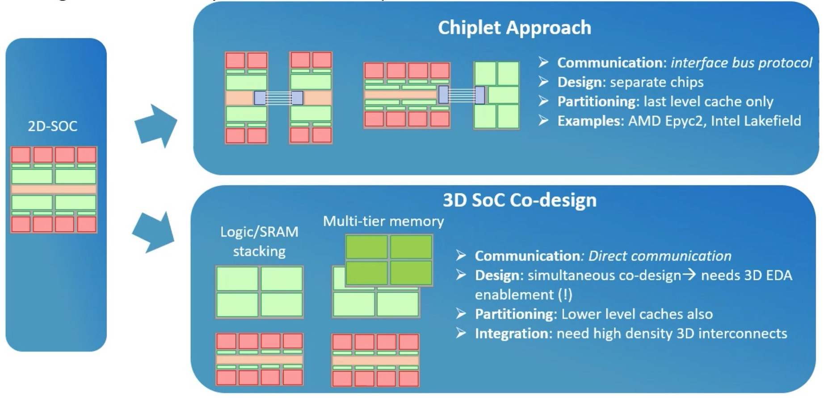
未来趋势
规模会继续缩小：
Buried power rail (BPR) power instead of distribution in interconnect;
Transistors move to gate all around nanosheets (for higher drive, lower leakage);
Using forksheets or CFET (complementary FET) to move the P and N transistors closer (4 Track);
关键材料至关重要：
Two-dimensional channel materials such as MoS2（二硫化钼）
For interconnect, we need a hybrid solution with a second metal like ruthenium （钌） (and a thinner barrier);
3D结构设计：
EDA tools for 3D SOC design；
Partition of Cache and Logic；
Back-Side Power Distribution.

Slide 31

工艺参数
Key CMOS Technology Parameters
Technology | 65 nm | 45 nm | 32 nm | 22 nm | 14 nm | 10 nm
Year of Use | 2005 | 2007 | 2009 | 2011 | 2013 | 2015
Device’s | IBM FPGA | Xeon | 4i | Intel Core7 | iPhone 6s | TSMC
Frequency | 1.8 GHz. | 1.8 GHz | 1.8 GHz | 1.8-3.0 GHz | 3.8 GHz | 3.8-4.0GHz
Gate Length | 35 nm | 30 nm | 25 nm | 18 nm | 12 nm | 9 nm
Kgate /mm2 | 0.8 | 1.5 | 2.8 | 5.2 | 9.0 | 16.0
Cost of Technology
Technology Node | 90 nm | 65 nm | 45 nm | 22 nm
Fab Cost in billions of dollars | 2.8 | 3.8 | 6.9 | 9.5
Process Development cost in billions | 2.2 | 2.6 | 3.2 | 6.8
Mask Steps currently used in various Technology Nodes
Node | 28 nm | 20 nm | 10 nm | 7 nm immersion | 7 nm EUV
Lithography Steps | 6 | 8 | 23 | 34 | 9
Overlay Metrology | 7 | 9-11 | 36-40 | 59-65 | 12

Slide 32

市场需求
https://omdia.tech.informa.com/OM014575

Slide 33

TSMC供应

Slide 34

110nm工艺新特性
单元库
1. 重视时序库，功耗库，噪声库
物理设计
2. 版图规划考虑划分
3. 提出时序驱动， SI驱动的布局
4. 考虑有用偏差的时钟树综合
5. 考虑天线效应规则，预防SI布线
6. 布线后优化WLM, DRV
签核分析
7. RC参数提取考虑三维模型
8. 考虑SI的精确静态时序分析模型
9. 考虑最好和最坏的Corner进行检查
10. 静态功耗和动态功耗分析
验证
11. 物理验证包含DRC, ERC, LVS
12. 基于扫描的逻辑等价检查
System Specifications
Architectural Design
Chip
Simulation
Functional Design
Simulation (Circuit)
Package and Test
Logic Synthesis
Emulation (System)
Logic Compiling
Fabrication
Std Cell Lib
Logic Optimization
Tech Mapping
Layout Post Processing
Device Modeling
Mask Generation
1. Parasitic Extraction
12. Equivalence Checking
Post Simulation
DRC/LVS
Physical Design
RET/OPC/ILT
Analysis
2. Floorplan
7. RC Extraction
3. Placement
Physical Verification
8. 9. Timing Analysis
4. Clock Tree Synthesis
11. LVS
10. Power
5. Routing
11. ERC
Noise
6. ECO
11. DRC

Slide 35
55nm工艺新特性
单元库
1. 考虑不同电源电压阈标准单元库
2. 电源切断技术；
物理设计
3. 版图规划IO区域设计，多芯片封装；
4. 考虑Clock Gate控制时钟树综合；
5. 状态保持电源门控制技术；
6. 功耗驱动布线；
7. 考虑MMMC和良率的设计优化技术；
签核分析
8. 考虑DFM，OPC的RC参数提取；
9. 考虑MMMC和AOCV的时序检查；
10. 多电源多电压和切断电源功耗分析；
验证
11. 物理验证考虑DFM, OPC和良率
12. 考虑DFT和ECO的形式验证
System Specifications
Architectural Design
Chip
Simulation
Functional Design
Simulation (Circuit)
Package and Test
Logic Synthesis
Emulation (System)
Logic Compiling
Fabrication
Std Cell Lib
Logic Optimization
Tech Mapping
Layout Post Processing
2. Device Modeling
Mask Generation
1. Parasitic Extraction
12. Equivalence Checking
Post Simulation
DRC/LVS
Physical Design
RET/OPC/ILT
Analysis
3. Floorplan
8. RC Extraction
Placement
Physical Verification
9. Timing Analysis
4. 5. Clock Tree Synthesis
11. LVS
10. Power
6. Routing
11. ERC
Noise
7. ECO
11. DRC

Slide 36
28nm工艺新特性
单元库
1. 会考虑SOI技术或FinFet器件模型，即Pcell变得复杂；
2. 考虑器件米勒效应；
物理设计
3. 考虑图依赖效应布局；
4. 考虑DP和通孔可靠性的布线；
5. 考虑DRC，EM和串扰的布线；
6. 布线后优化考虑DVI, DFI, LDE；
7. 考虑修时序设计优化技术；
签核分析
8. 考虑耦合电容的参数提取；
9. 考虑MMMC和SSTA的时序检查；
10. 分析电压降
验证
11. 物理验证考虑多重光刻的设计规则；
12. 进行ESD和电流密度检查；
System Specifications
Architectural Design
Chip
Simulation
Functional Design
Simulation (Circuit)
Package and Test
Logic Synthesis
Emulation (System)
Logic Compiling
Fabrication
Std Cell Lib
Logic Optimization
1. Device Modeling
Tech Mapping
Layout Post Processing
2. Parasitic Extraction
Mask Generation
Equivalence Checking
DRC/LVS
Post Simulation
Physical Design
RET/OPC/ILT
Analysis
Floorplan
8. RC Extraction
3. Placement
Physical Verification
9. Timing Analysis
7. Timing Optimization
12. ESD/CD
Power
Clock Tree Synthesis
LVS
Noise
4. 5. Routing
ERC
10. IR Drop
6. ECO
11. DRC (MP)

Slide 37
01
背景目标
02
设计思路
03
设计内容
04
设计方式

Slide 38
开源EDA工具目标和任务
iEDA
研用结合：实用牵引，以用带研，研以致用
A. EDA基础设施：软件基础组件，如：文件、解析器、数据库、基础数据结构等，供EDA工具使用
B. EDA点工具：完成各个功能的工具模块，如：逻辑综合、布局布线、物理验证等
C. 芯片设计流程：一套用于设计芯片版图的智能自动化流程，通过调用EDA工具的接口命令完成芯片设计
D. 测试芯片集：构建覆盖多种规模、多种场景，具备多种粒度的基准测试集
E. 工艺库：工业级可生产的开源工艺库和单元库，是推动开源EDA发展的重要保障
F. 研发生态：开源EDA平台聚集国内优势力量，推动科学研究提供了新的思路（水滴石穿计划）
G. 应用生态：推动形成典型应用场景，由教学场景入手（一生一芯计划），逐步打造产品级示范应用
G.应用生态
F.研发生态
从低工艺(110nm)，至更高工艺(55nm/28nm, 甚至14nm)
D.测试芯片集
C.芯片设计流程
E.
工艺库
B.EDA工具
从小规模SoC芯片(数十万门)，到更大规模(上千万到上亿)
电路仿真
单元设计
逻辑综合
物理设计
签核分析
物理验证
版图处理
从部分单点EDA设计工具，到完整EDA设计+验证工具链
从EDA工具可用，工具功能完善可靠，到工具质量和性能良好
A.EDA基础设施

Slide 39




开源EDA项目的几条线
问题拆解
关键技术
问题拆解中的关键问题
自研
开放课题
比赛
EDA和芯片设计企业
对口企业
国内骨干EDA企业和芯片设计企业
技术成果
学术界经典问题
支持新型工艺
（硅光）
框架和平台
实现代码原型
摸清工具原理
助力科研
构建生态
可完成 RTL-GDSII 的开源EDA平台
跑通
架构设计质量高
代码和文档质量高

Slide 40
EDA工具：问题拆解
开源EDA平台拆解分为六级进行：EDA工具平台，EDA工具模块，EDA工具，EDA子工具，工具内步骤，独立问题和算子（白皮书）
EDA Platform
EDA Modules
Tools
Sub-Tools
Steps
Operators
……
Logic Compiling
……
Logic Optimization
……
Logic Synthesis
Initial Placement
Tech Mapping
Assign Cell to Right Region
……
Floorplan
Global Placement
Greedy
Cell Respread
Physical Design
Placement
Post Global Placement
Tetris
CTS
Align Cell to Row
EDA Flow
Routing
Legalization
Reorder Cell in a Row
Dynamic Programming
Sign Off
STA
Quadrable Programming
Detail Placement
Spread Cell in a Row
Power Analysis
Noise Analysis
……
Refinement
Linear Programming
Physical Verification
DRC / ERC
Check Legality
Local Search Method
LVS
……
……
1个EDA平台
Layout Processing
OPC / RET
……
Mask Generation
>1万个解决方案
……
7个主要方向
9大功能模块
45个工具
101个子工具
>600个步骤
>2000个问题

Slide 41
Modules and Tools
Modules | Tools/
Simulation | Circuit Simulation | RTL Simulation | FPGA Simulation | System Emulation | Device TCAD | Debug
Logic Synthesis | Logic Compilation | Logic Represent | Logic Optimization | Tech Map | Test Insertion | Equivalence Verification
Physical Design | Floorplan | Placement | CTS | Timing Optimization | Routing | ECO
Verification | DRC | ERC | ESD | Antenna Effect | Current Density | LVS
Sign Off | RC Extraction | STA | Power | IR Drop | Noise | Electro Migration
Layout Process | DFM | Via/Metal Reliable | Test Pattern | Hotspot | RET/OPC/ILT | Mask Generation
Package & Test | Wafer Test | Die Test | Beyond Die | 2.5D/3D Package | Package Test | System Test
Database | Files | Parsers | Data Structure | Database | Manager | Service
Flow | Interface | GUI | Script | Flow | Architect | Intelligent Platform
Benchmark | Library (PDK/SCL) | RTL Designs | Modules Benchmark | Tools Benchmark | Steps Benchmark | Problems Benchmark
Operator | Numerical Calculation | PDE | Optimization | Combinatorial Optimization | Algebra Combination | NP-Hard

Slide 42



















EDA工具：关键技术
六步骤拆解EDA工具，抽象为去EDA属性的小颗粒的数学，算法，软件和性能问题。形成关键技术问题，并描述成白皮书。

Slide 43




EDA工具：框架
物理设计
布局
全局布局

Slide 44
iPD-EDA软件架构
测试集
Flow
用户交互
GUI
Shell/TCL/Python
业务交互层
功能模块
异常处理
核心工具模块
辅助模块
数据结构
LS
MAP
PS
FP
GP
算法库
数值优化
数值计算
图计算
Log
DP
TO
CTS
GR
DR
组合优化
逻辑运算
运筹规划
Report
业务功能
微分方程
智能学习
启发式
DRC
LVS
RCX
STA
PA
Test
模块交互业务管理
性能
加速器
线程池
高性能计算库
Utility
策略管理
并行计算
异构计算
…
共有数据访问接口层
（支持所有业务数据）
工具模块数据访问层
LS, MAP, FP, GP, DP, TO, CTS, GR, DR, DRC, ERC, LVS, RCX, STA, NA, PA
数据配置层
数据库
配置参数
Design
Network
Library
Timing
Tech
Layout
数据库
管理
兼容
模块
数据构建层
公共数据
私有数据
数据源
文件解析器
.v(RTL) / .v(netlist) / .def / .lef / .lib / .sdc / .spef / .sdf / .gds / .sp / .model …

